Slide 1

Alfonso Awadalla, Jade Sillere, Julian Rojas, Maela Guillaume-Le-Gall, Sofia Vaca

Slide 3
Déterminant - Qualité de l’air

Slide 4

Indicateur: nombre moyen de jours supérieur ou égal à mauvais pour la qualité de l’air (Pt.1)
Source of the BDD:
Raw daily pollution data on PM2.5, PM10, NO2, SO2 and O3 from every station in every region from Geod’air from 1/1/23 - 31/12/23 (inclusive).
Resolution of the data: Station-level
Difference from Cahier des Charges index:
Index using recreated ATMO index due to lack of a login for ATMO France data
Using proportion of days of a year instead of count

Slide 5
Indicateur: nombre moyen de jours supérieur ou égal à mauvais pour la qualité de l’air (Pt.2)
Data issues:
Incomplete availability of pollutant data for all regions
e.g., all SO2 data is missing for Bretagne and Île-de-France
Incomplete coverage of data for regions which do have pollutant data files
e.g., incomplete yearly coverage for SO2 data for Corse
Notes:
Corse issues with yearly coverage: last day is 2023/08/10 for station ZAR BASTIA and 2023/08/17 for station ZAR AJACCIO.

Slide 6
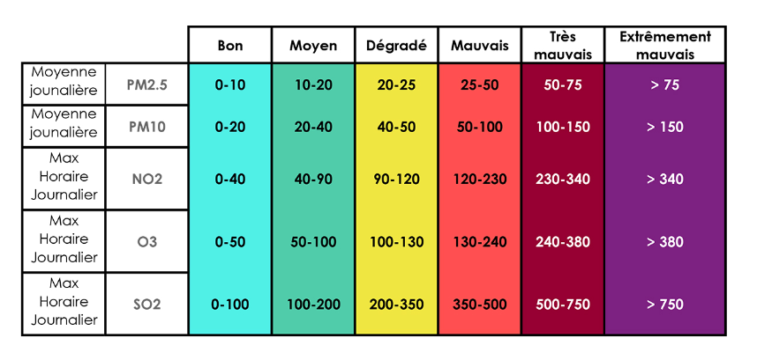
Indicateur: nombre moyen de jours supérieur ou égal à mauvais pour la qualité de l’air (Pt.3)
ATMO Sub-score
1 2 3 4 5 6
Methodology followed:
Recreated ATMO index using their methodology
Took the percentage of days over the year available which have an ATMO score greater than or equal to 3 out of the total number of days available.
Source: ATMO France
Notes:
ATMO methodology:
Each range of each of the 5 pollutants is assigned an ATMO sub-score of 1-6 (from best-to-worst) and the daily ATMO index score is the maximum ATMO daily sub-score of the 5 pollutants.

Slide 7
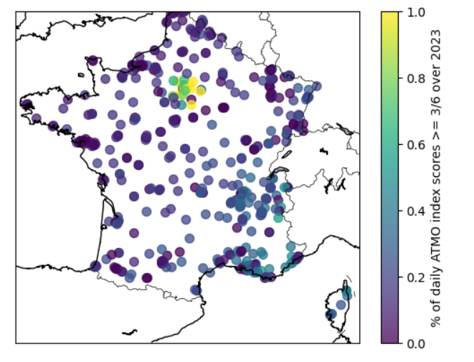
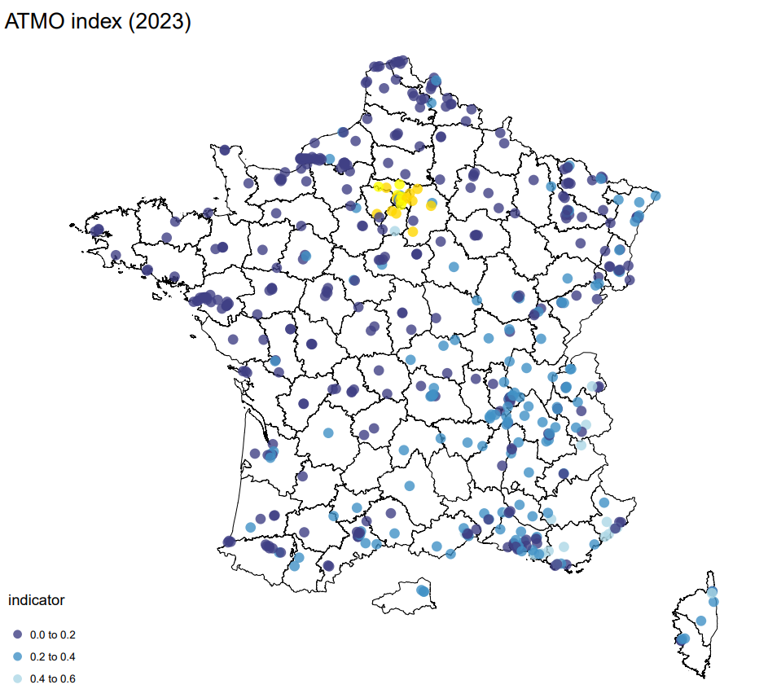
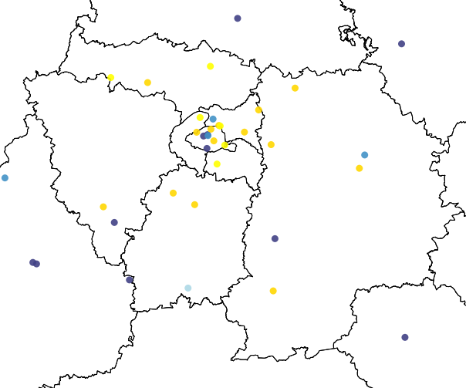
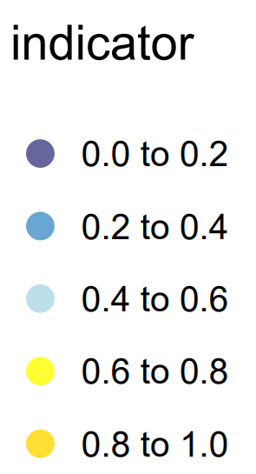
Indicateur: nombre moyen de jours supérieur ou égal à mauvais pour la qualité de l’air (Pt.4)
Indicator at highest resolution (station-level)
Focus on area with highest coverage (station-level)
*
Focus: Ile-de-France
* Proportion of days available in 2023 with an ATMO score of at least 3/6

Slide 8
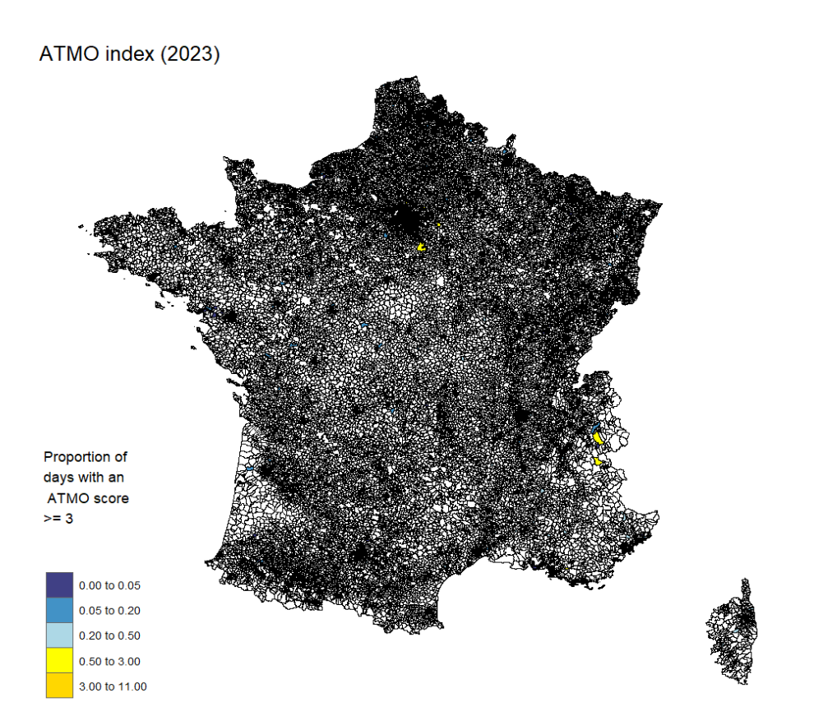
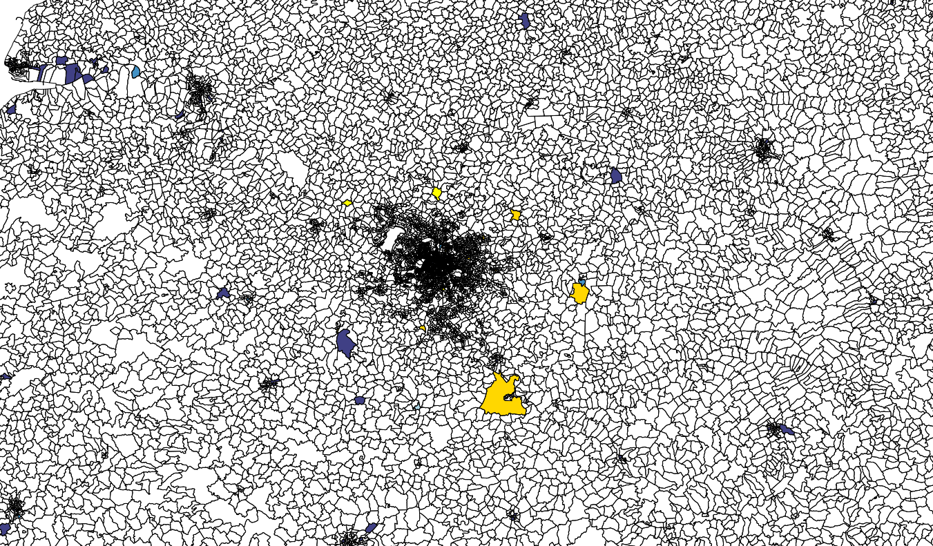
Indicateur: nombre moyen de jours supérieur ou égal à mauvais pour la qualité de l’air (Pt.5)
Concerns with / limitations of indicator:
Incomplete coverage which could lead to a misleading score if the missing data is significant enough
Focuses on worst pollutant performance which ignores that the area might be doing well on other pollutants
Scaling up to IRIS/Commune →
Which radius to select?
Focus on section of IRIS-level plot
Focus: Ile-de-France
Notes:
1st Bullet Point: e.g., if the missing SO2 data would have had an impact on the ATMO score.
3rd Bullet Point: take if located in IRIS or do surrounding radius and if it is the latter, what radius to choose?

Slide 9
Indicateur: SOMO35 (Pt.1)
Source of the BDD:
Raw daily pollution data on O3 from every station in every region from Geod’air from 1/1/23 - 31/12/23 (inclusive).
Resolution of the data: Station-level
Difference from Cahier des Charges index:
Index recreated due to lack of a login for ATMO France data
Issues with data:
Incomplete yearly coverage of data for all regions
Notes:
Incomplete yearly coverage example: O3 data does not cover the whole year for all sites in Auvergne-Rhône-Alpes (Les ménuires site data coverage for 2023 begins from 04/01/23 and the Valence Urb. Centre site data coverage for 2023 begins from 2023/07/12).

Slide 10
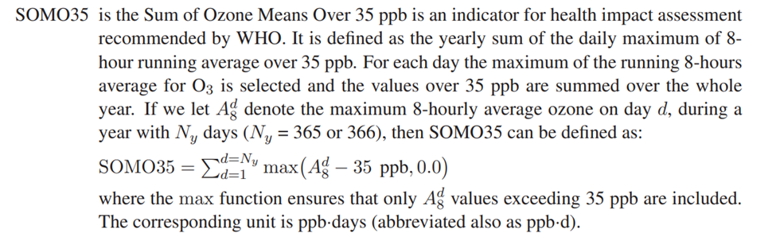
Indicateur: SOMO35 (Pt.2)
Methodology followed:
Recreated the SOMO35 indicator following the methodology:
For each daily max hourly Ozone data point:
if the maximum exceeds 70 µg/m3 (35 ppb) then the daily score is the difference
otherwise it is 0
Summing over the daily scores for the year.
Source: European Monitoring and Evaluation Programme

Slide 11
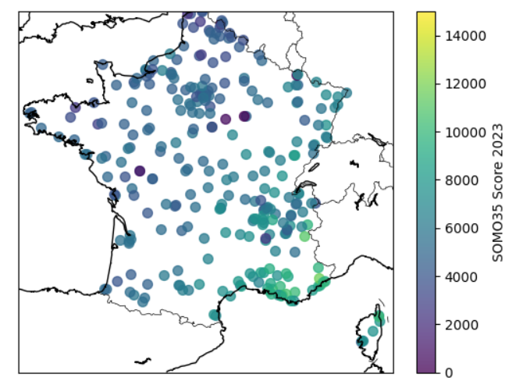
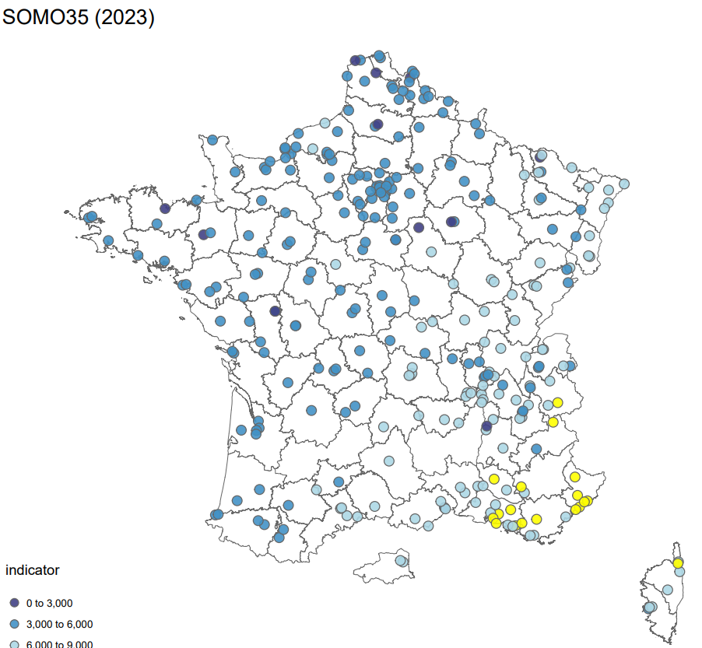
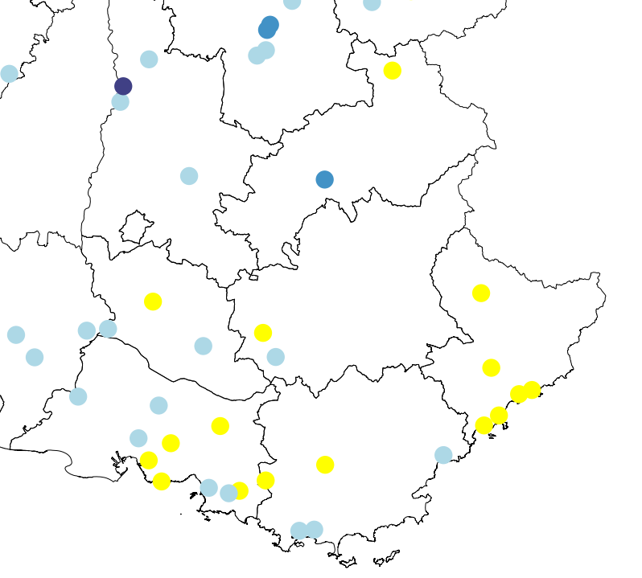
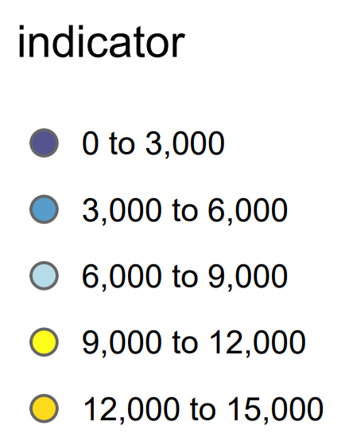
Indicateur: SOMO35 (Pt.3)
Indicator at highest resolution (station-level)
Indicator with focus on area with highest coverage (station-level)
*
Focus: Provence-Alpes-Côte d'Azur
* SOMO35 Score

Slide 12
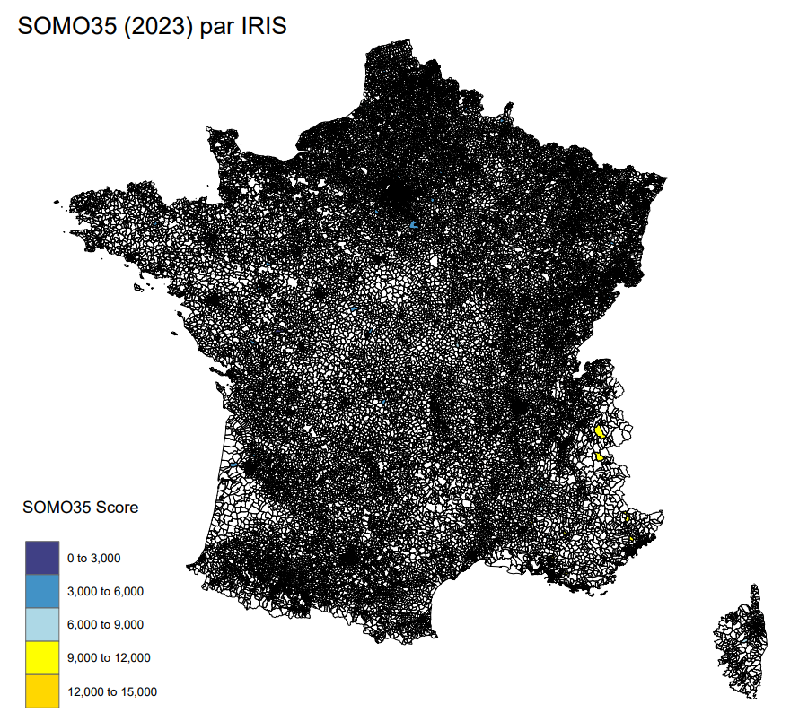
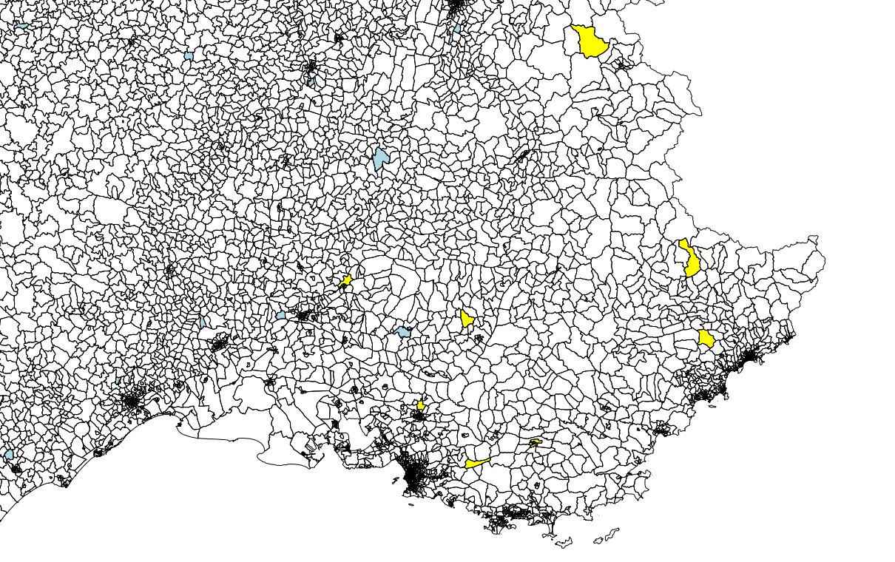
Indicateur: SOMO35 (Pt.4)
Concerns with / limitations of indicator:
Incomplete coverage which could lead to a misleading score especially since it is a summing measure
Scaling up to IRIS/Commune →
Which radius to select?
Focus on section of IRIS-level plot
Focus: Provence-Alpes-Côte d'Azur
Notes:
Issues with coverage hindering interpretation example:
E.g., on top of sites with incomplete yearly coverage already mentioned, O3 data for site AIRVAULT 3 in Nouvelle-Aquitaine only covers 98 days which contributes to its comparatively low SOMO35 score (c.700).

Slide 13


Déterminant - Gestion des eaux

Slide 14
Indicateur: Indicateur qualité des eaux souterraines
Score corresponding to the sum of weighted sites. Data extracted in January 2020.
Weighting is defined based on the type and status of the site to attempt to account for the variation in nature and magnitude of pressures and impacts. Weighting is also adjusted to consider the proximity of populations to the sites (INERIS, page 28).
Two databases were used:
BASOL.json (base de sites et sols pollués)
icpe.geojson (Geographic file for the location of classified installations)

Slide 15
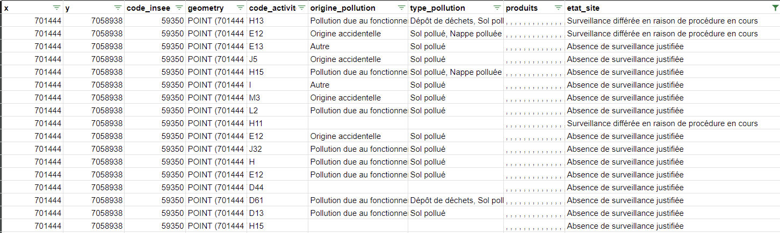
Indicateur: Indicateur qualité des eaux souterraines
Merged data base used to calculate the weighted score by code_insee
Step 1:
Calculate the weights by the condition site: After filtering by 'code_activite_icpe', 'origine_pollution', 'type_pollution', 'produits', 'etat_site' and 'code_insee':
We get two unique elements in the 'etat_site':
Absence de surveillance justifiée: 1685
Null values: 5270
Surveillance différée en raison de procédure en cours: 377
Notes:
out step 1 and 2 on the same slide, make it clear

Slide 16
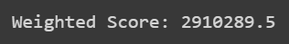
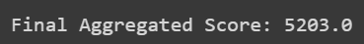
Indicateur: Indicateur qualité des eaux souterraines
Step 2:
Weight of the site condition:
'Absence de surveillance justifiée': 1,
'Surveillance différée en raison de procédure en cours': 0.5
We get a score of:
Step 3:
Weighting the adjusted score to proximity of population sites:
'0 - 250 meters' : 1,
'250 - 500 meters' : 0.5
'500 - onwards' : 0.2
We get a score of:

Slide 17
Indicateur: Indicateur sécheresse
By geographical area, weight the risk of a territory to face drought episodes according to the number of days the territory is under alert, reinforced alert, or crisis.
Data used:
zones_arretes_en_vigueur.geojson
all_zones.shp

Slide 18
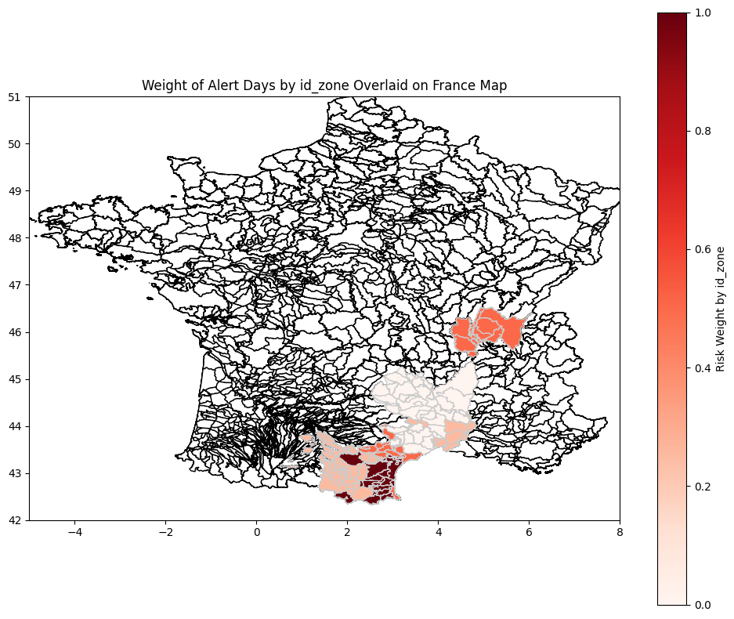
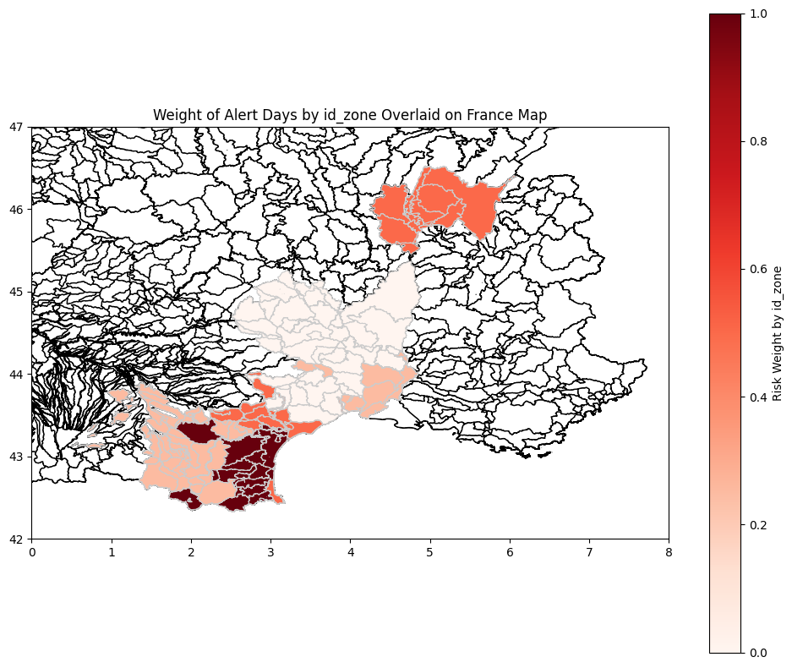
Indicateur: Indicateur sécheresse
Zones/Departments
Lozère, Ain, Gard, Aude, Hérault, Pyrénées-Orientales
Drought risk by geographical area: Alerte (0), Vigilance (0.25), Alerte renforcée (0.5), Crisis (1)

Slide 19
Déterminant N.2 - General Comments
Normalizing Parameters
Bringing the parameters to a common scale (in this case, normalizing the scales), makes it easier to compare them. Comparing the values, without normalization, on different scales, can be misleading and affect the statistical and mathematical interpretability.
In addition, normalizing the data makes it easier to perform visualization exercises, like the map on the previous slide.
Limitation of the data and interpretability
While the steps were followed from the INERIS document, to get the weighted adjusted score to proximity of population sites, the interpretation on how to read the score is not clear.
The geometry column to link it to the shapefile, in order to create the maps, does not contain all the regions in France.

Slide 20
Déterminant - Biodiversité

Slide 21
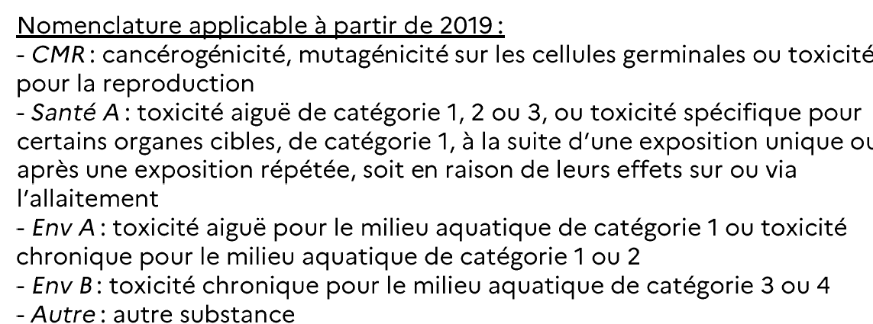
Indicateur: Quantités de pesticides achetés par code postal
Issues with data:
The data available was by postal code and the categories for each pesticide are different from the ones that allow to ponderate by the coefficient “relatif a la toxicité des substances pour l’année 2018”
Indicator proposed:
Total quantity of substance in kilograms bought by postal code according to the categories that group the substances.

Slide 22
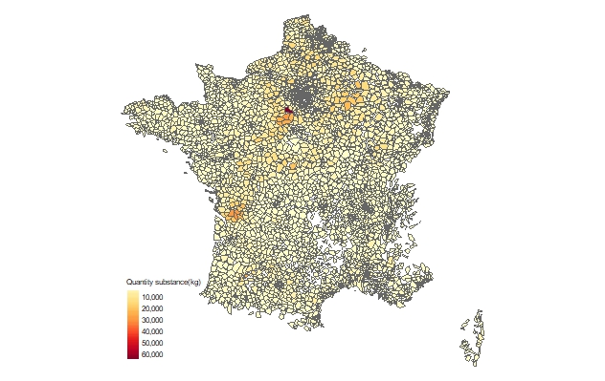
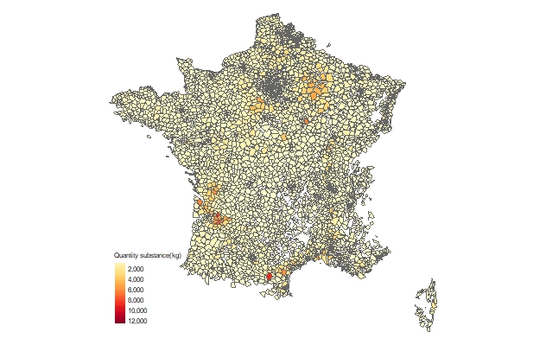
Indicateur: Quantités de pesticides achetés par code postal
CMR:
Santé A:

Slide 23
Indicateur: Quantités de pesticides achetés par code postal
Methodology followed:
Process the substances bought by postal code. Collapse the information for it to be by postal code and category of the substance
Use a geojson file that has the relation between postal codes and polygons
Merge the polygons with the pesticides by postal code and map them.
Concerns with / limitations of indicator:
At the end it is one indicator for each category of the substance of the pesticide.
Questions/suggestions for the indicator:
Idea to aggregate the categories of pesticides in one indicator, how should we assign weights to each category of pesticide?

Slide 24

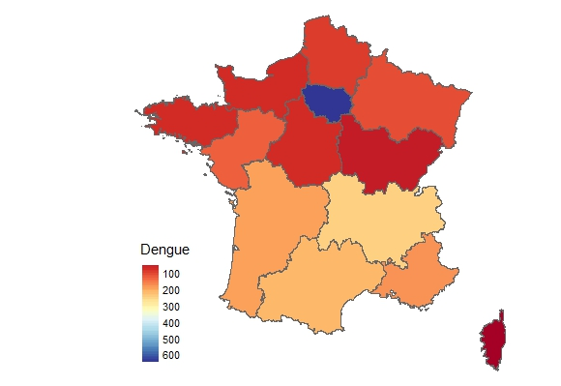
Indicateur: Cas importés de dengue en France métropolitaine
Source:
Methodology:
Extract the number of Dengue cases by region in France
Using tmap package (R) plot these cases by region
Limitations/Concerns:
The information is only available by region and from the 1st of may to the 8th december 2023.
For other type of mosquitos such as Chikungunya and Zika the cases are too few by region (0-10)
Doubts on the relevance of these indicators

Slide 25
Déterminant - Temperature

Slide 26

Indicateur: Taux de couvert forestier
Source :
Data in the form of 84 different GeoTiff files covering France
Methodology :
Extract value and coordinate from each pixel of every geospatial data and merge all the points
Downloaded shapefiles from INSEE for each scale → fill those pixels in each polygons and take the mean value
Using tmap package (R) we can plot our tree cover indicator for each scale

Slide 27
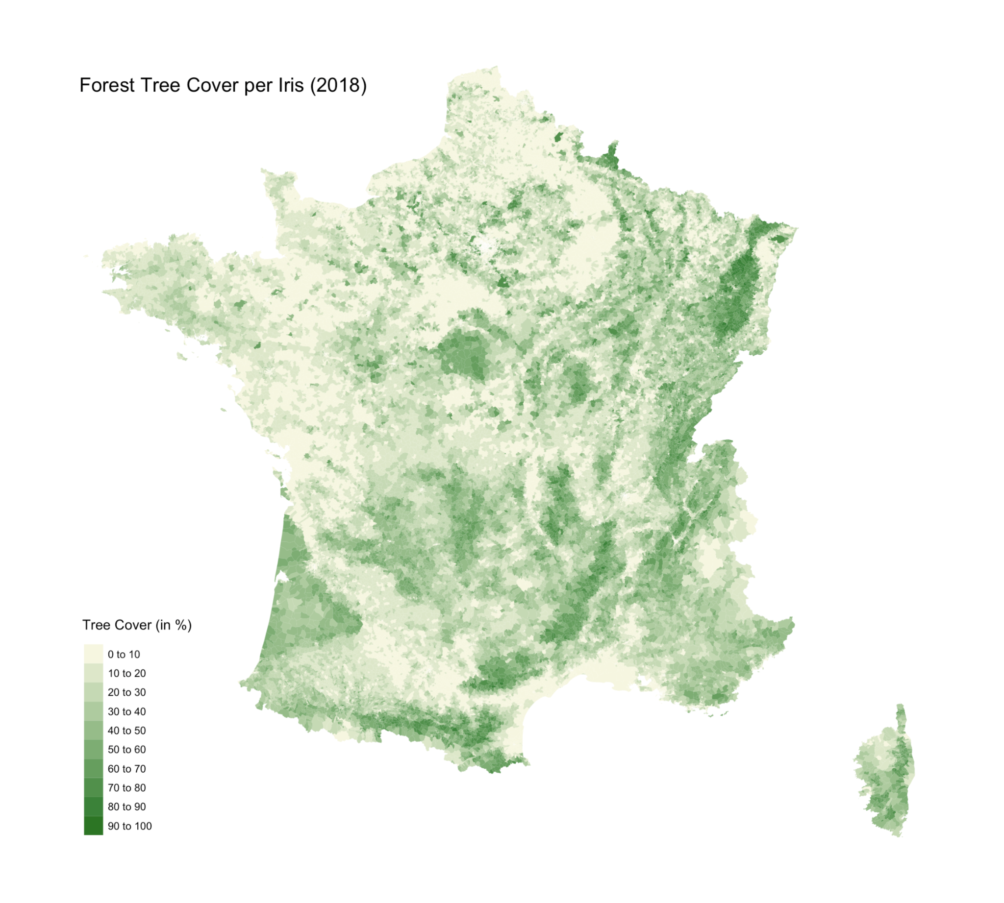
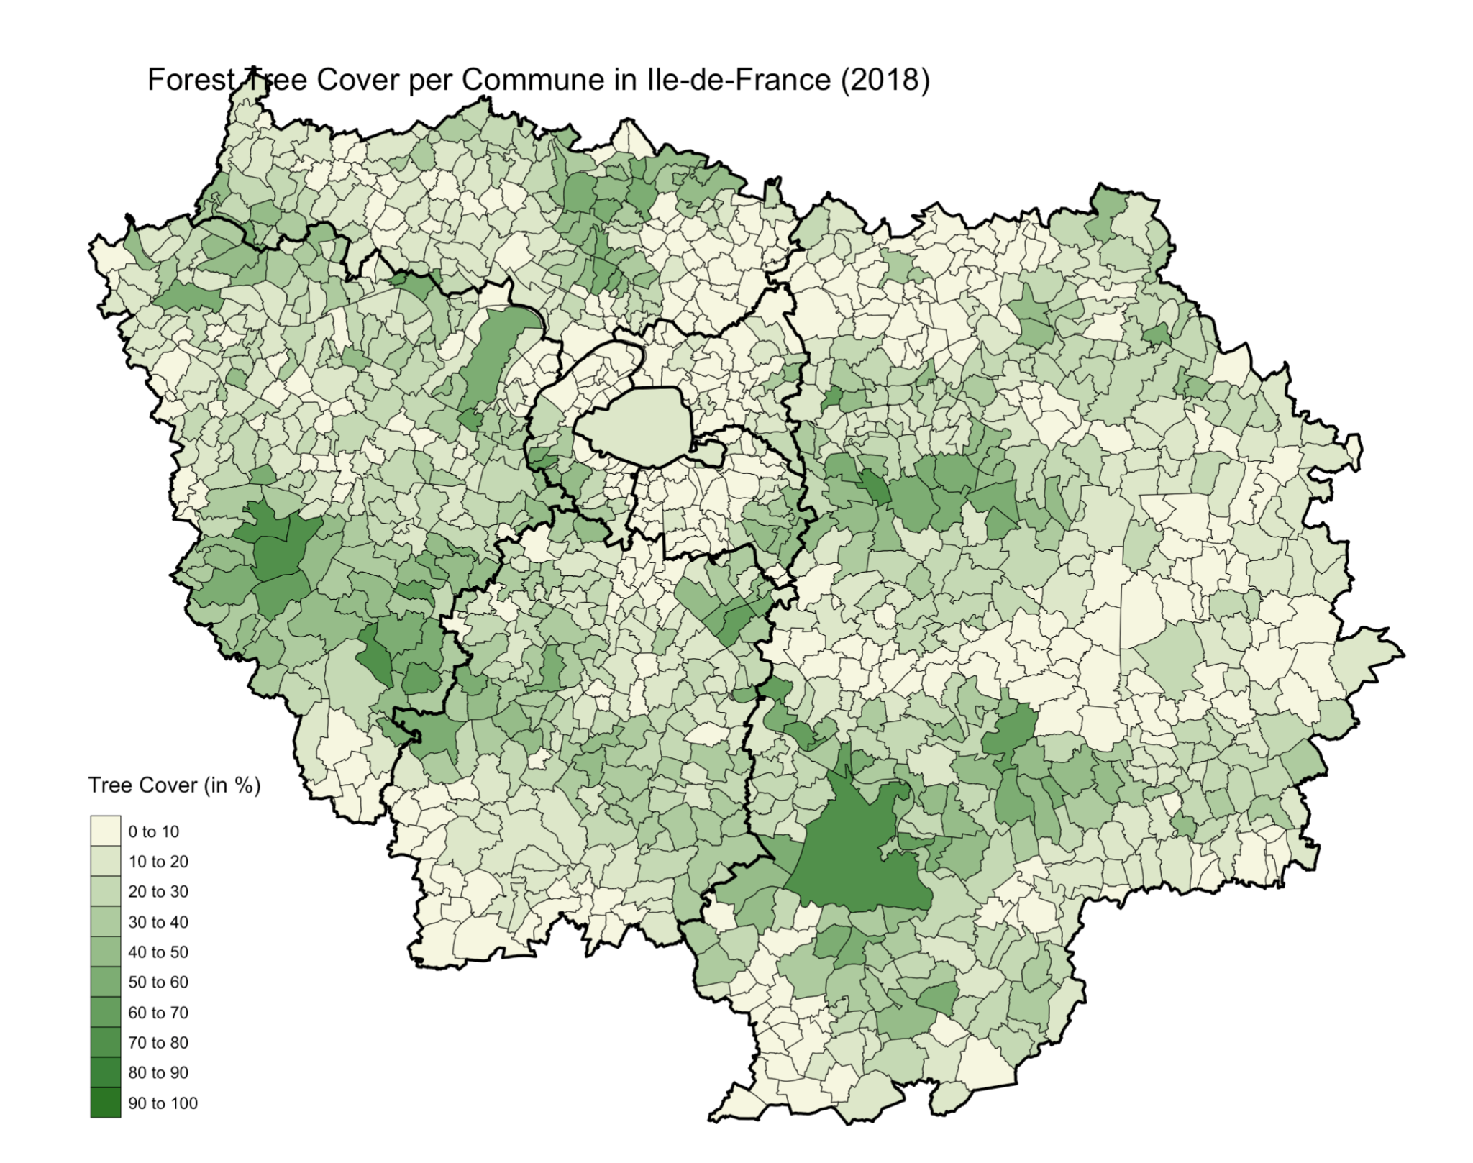

Slide 28
Indicateur: Taux de couvert forestier
Description of the indicator:
Density of tree cover across the country
Iris, communes, departments and regions spatial resolutions
Data ranges from 0% to 100% → areas with no tree cover up to those completely covered by trees
Based on 2018 data
Concerns with / limitations of indicator:
Using a 10x10 meter coverage was a complicated in term of computational power and visualization. So instead, Iris level is the minimum coverage chosen. (?)

Slide 29
Indicateur: Taux de surface imperméabilisée
Source:
Data in the form of 84 different GeoTiff files covering France
Methodology followed (same as in the tree cover indicator):
Extract value and coordinate from each pixel of every geospatial data and merge all the points
Downloaded shapefiles from INSEE for each scale → fill those pixels in each polygons and take the mean value
Using tmap package (R) we can plot our tree cover indicator for each scale
Description of the indicator:
Tool that maps out the Imperviousness Density 2018 across the country in the range from 0% to 100%.
Operates at 3 spatial resolutions: communes, departments and regions.

Slide 30
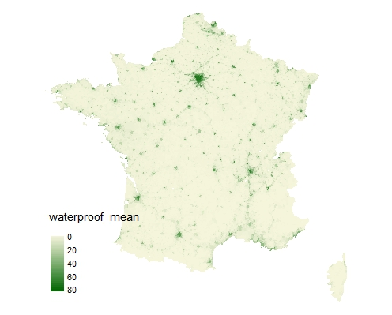
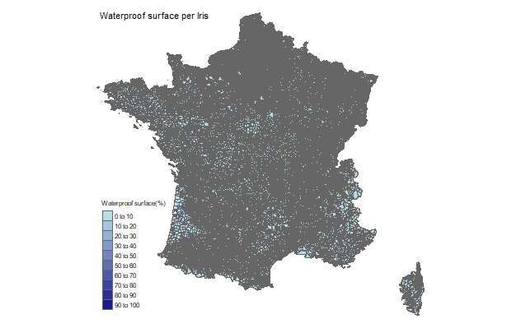
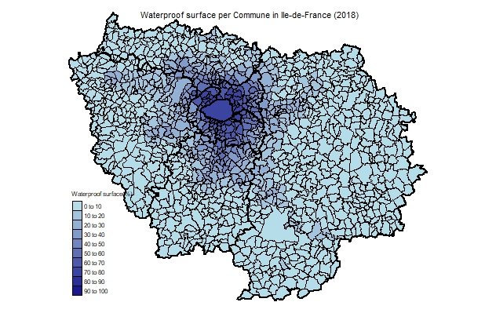
Indicateur: Taux de surface imperméabilisée
Iris:
Ile de France:

Slide 31
Déterminant - Pollution lumineuse/luminosité

Slide 32
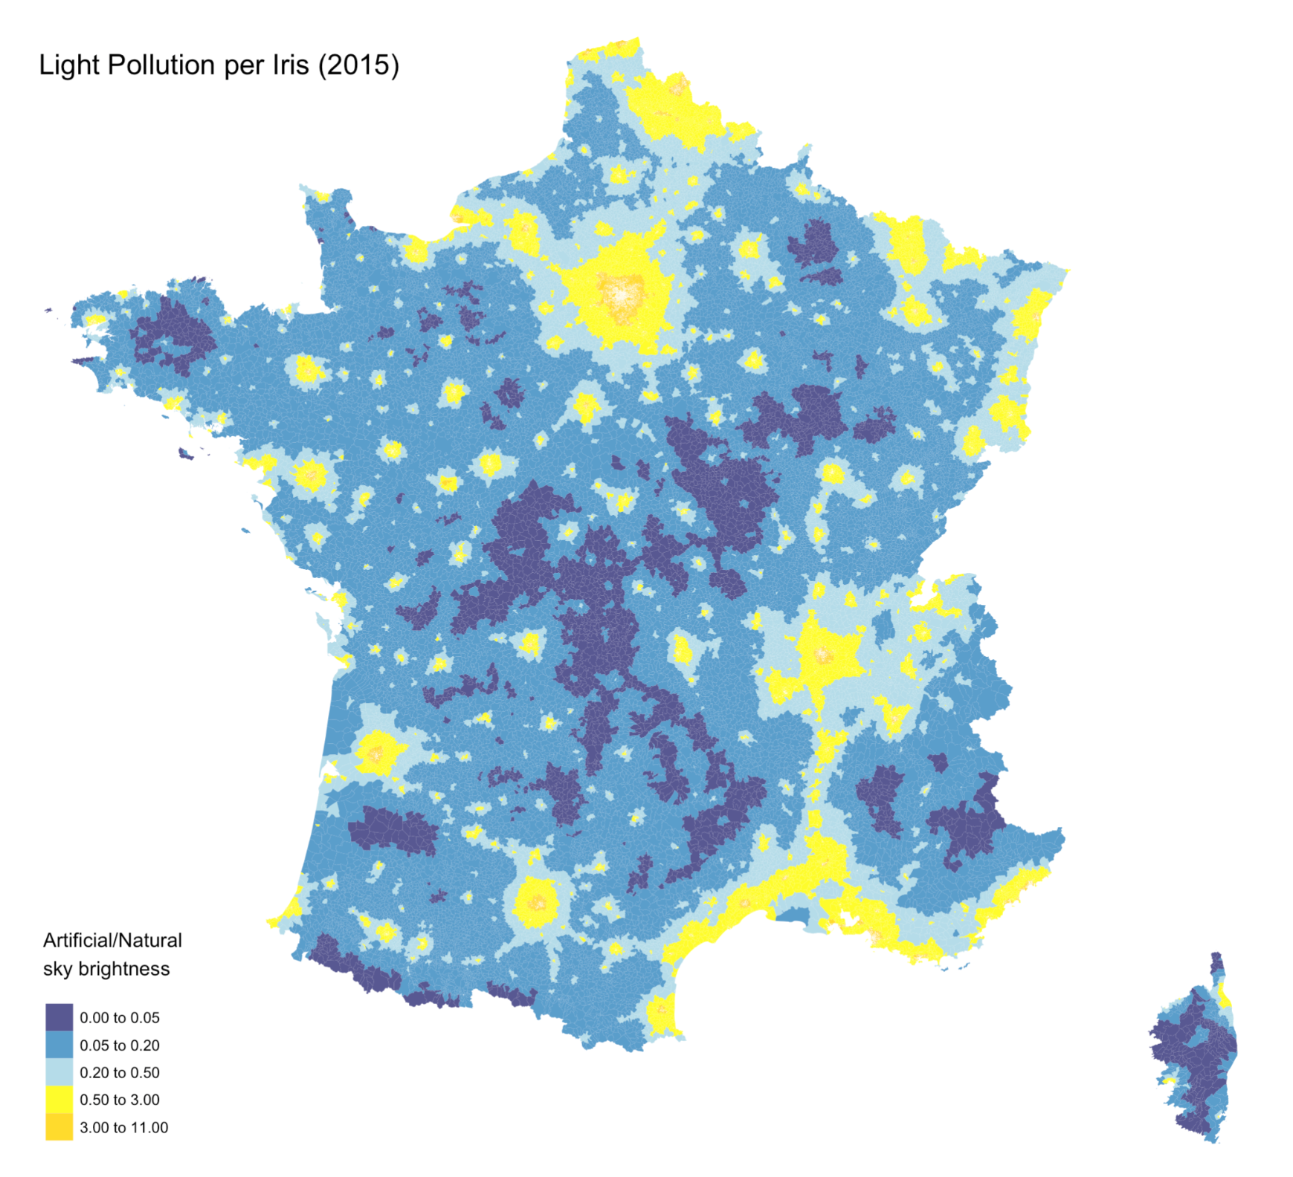


Indicateur: Radiance
Source :
Data in the form 1 GeoTiff file covering the world
Methodology :
Crop the World Tiff file to France by using a France shapefile from the EU Environment Agency
Extract value and coordinate from each pixel
Downloaded shapefiles from INSEE for each scale → fill those pixels in each polygons and take the mean value
Using tmap package (R) we plot our radiance indicator for each scale

Slide 33
Indicateur: Radiance
Description of the indicator:
Artificial night sky brightness [microcandelas per square meter (mcd/m^2)]
Ratio of artificial to natural sky brightness, focusing solely on artificial lighting
Ratios range 0 to 11 → areas with no light pollution to those with pollution 11 times above natural levels
Iris, Communes, Departments, and Regions scale available
Based on 2015 data

Slide 34
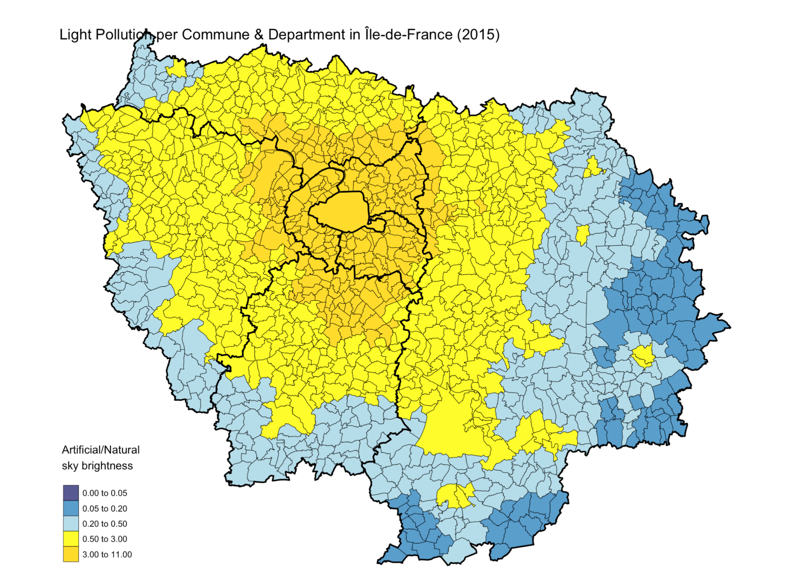

Slide 35
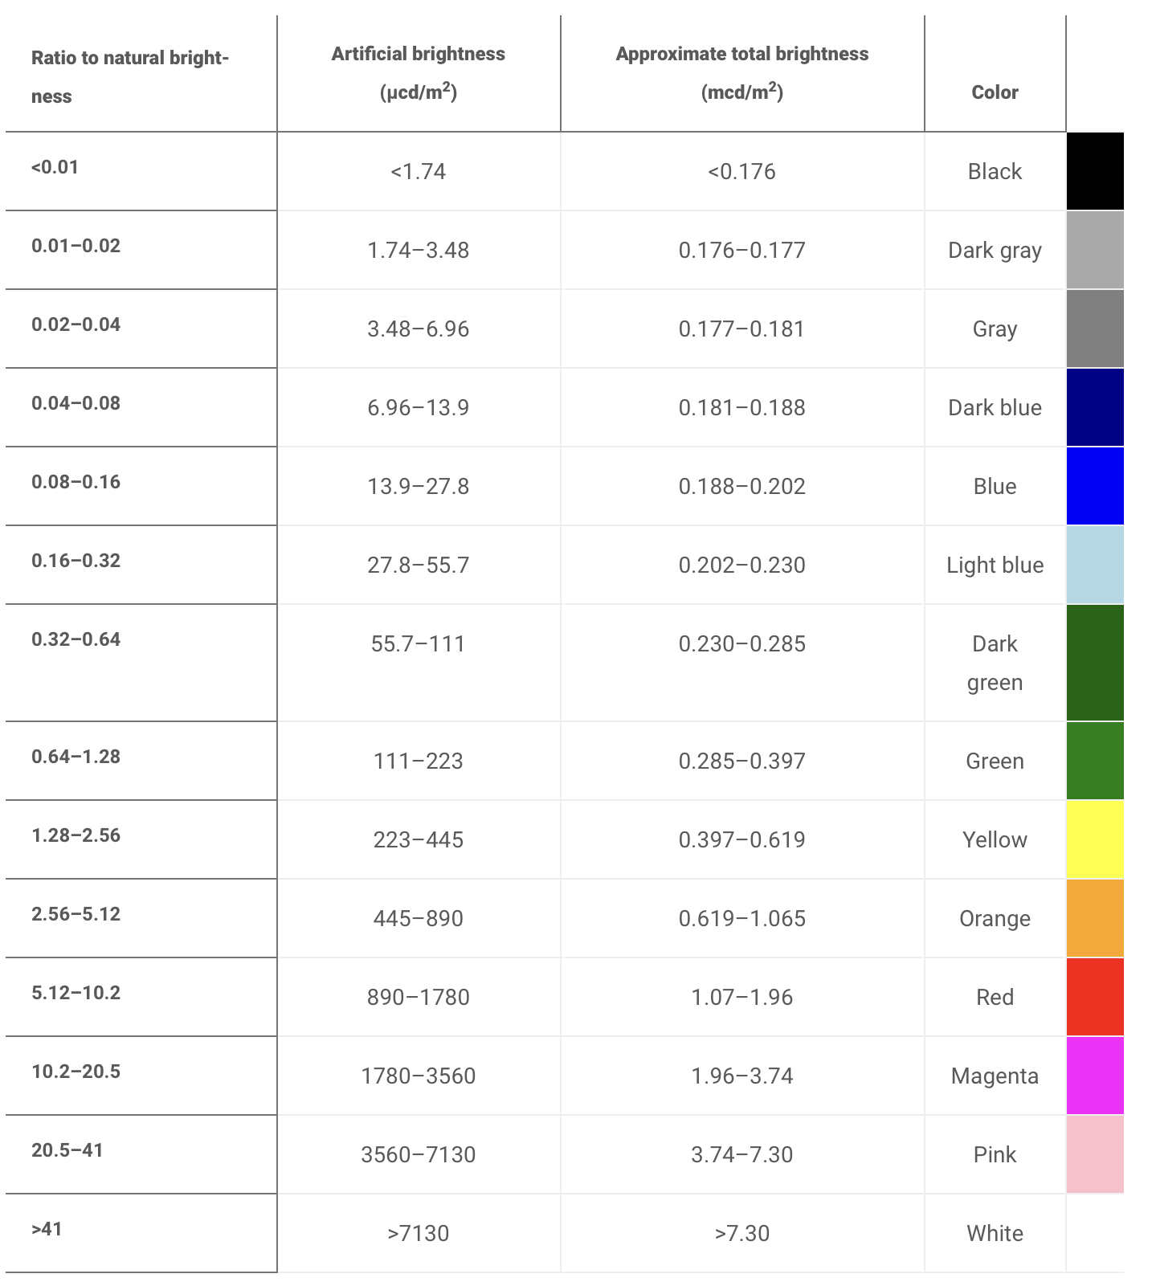
Indicateur: Radiance
Concerns with / limitations of indicator:
Same as other indicators, Iris level is the minimum coverage chosen for visualisation concerns
Visualisation intervals of data are chosen arbitrarily but based on some sources
paper that presented this data

Slide 36
Determinant - Physical and sports activities

Slide 37
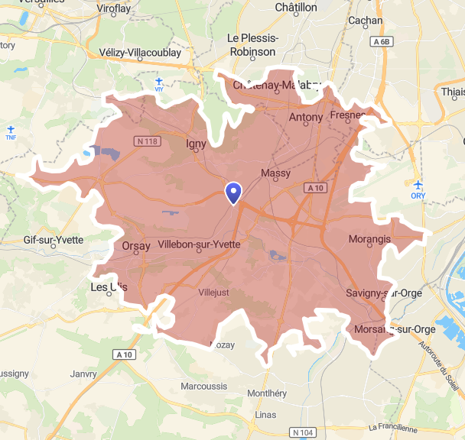
Indicateur: Nombre d’infrastructures sportives accessibles à 15 minutes en voiture
First step : Create isochrones
Calculate commune centroids
Calculate the area within a 15-minute drive from the centroid
Using Open Source Routing Machine (OSMR) : calculating reel travel time by road
(by car, off-peak)
Example : Palaiseau isochrone, 15 minutes by car

Slide 38
Indicateur: Nombre d’infrastructures sportives accessibles à 15 minutes en voiture
Second step : Calculate the number of sports infrastructures within the isochrone
Data : GPS coordinates of all sports infrastructures → 1 point = 1 infrastructure
Sum the number of infrastructure present in the isochrone
Link the isochrone to the commune
Cut into deciles for visualization
Source : Recensement des équipements sportifs, espaces et sites de pratiques. Ministère des Sports.

Slide 39
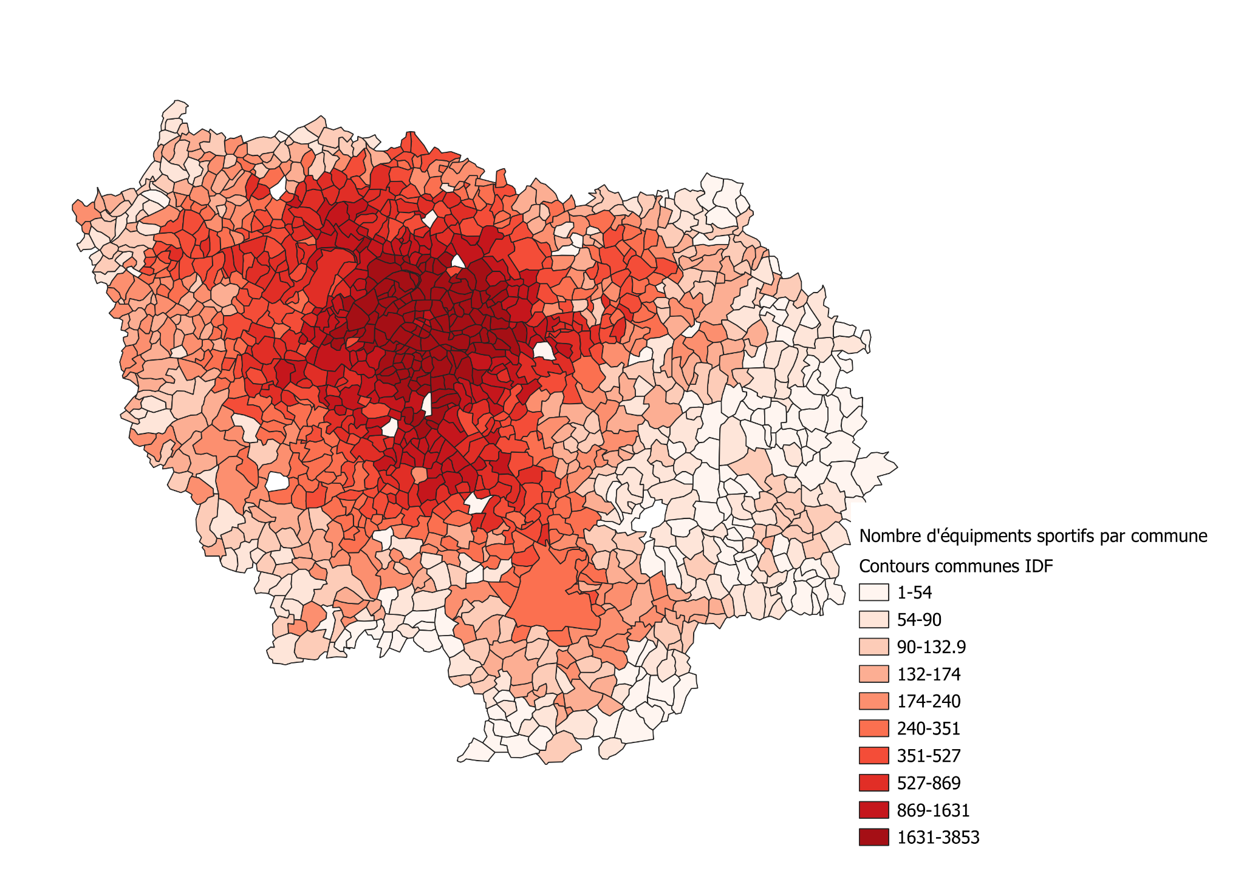
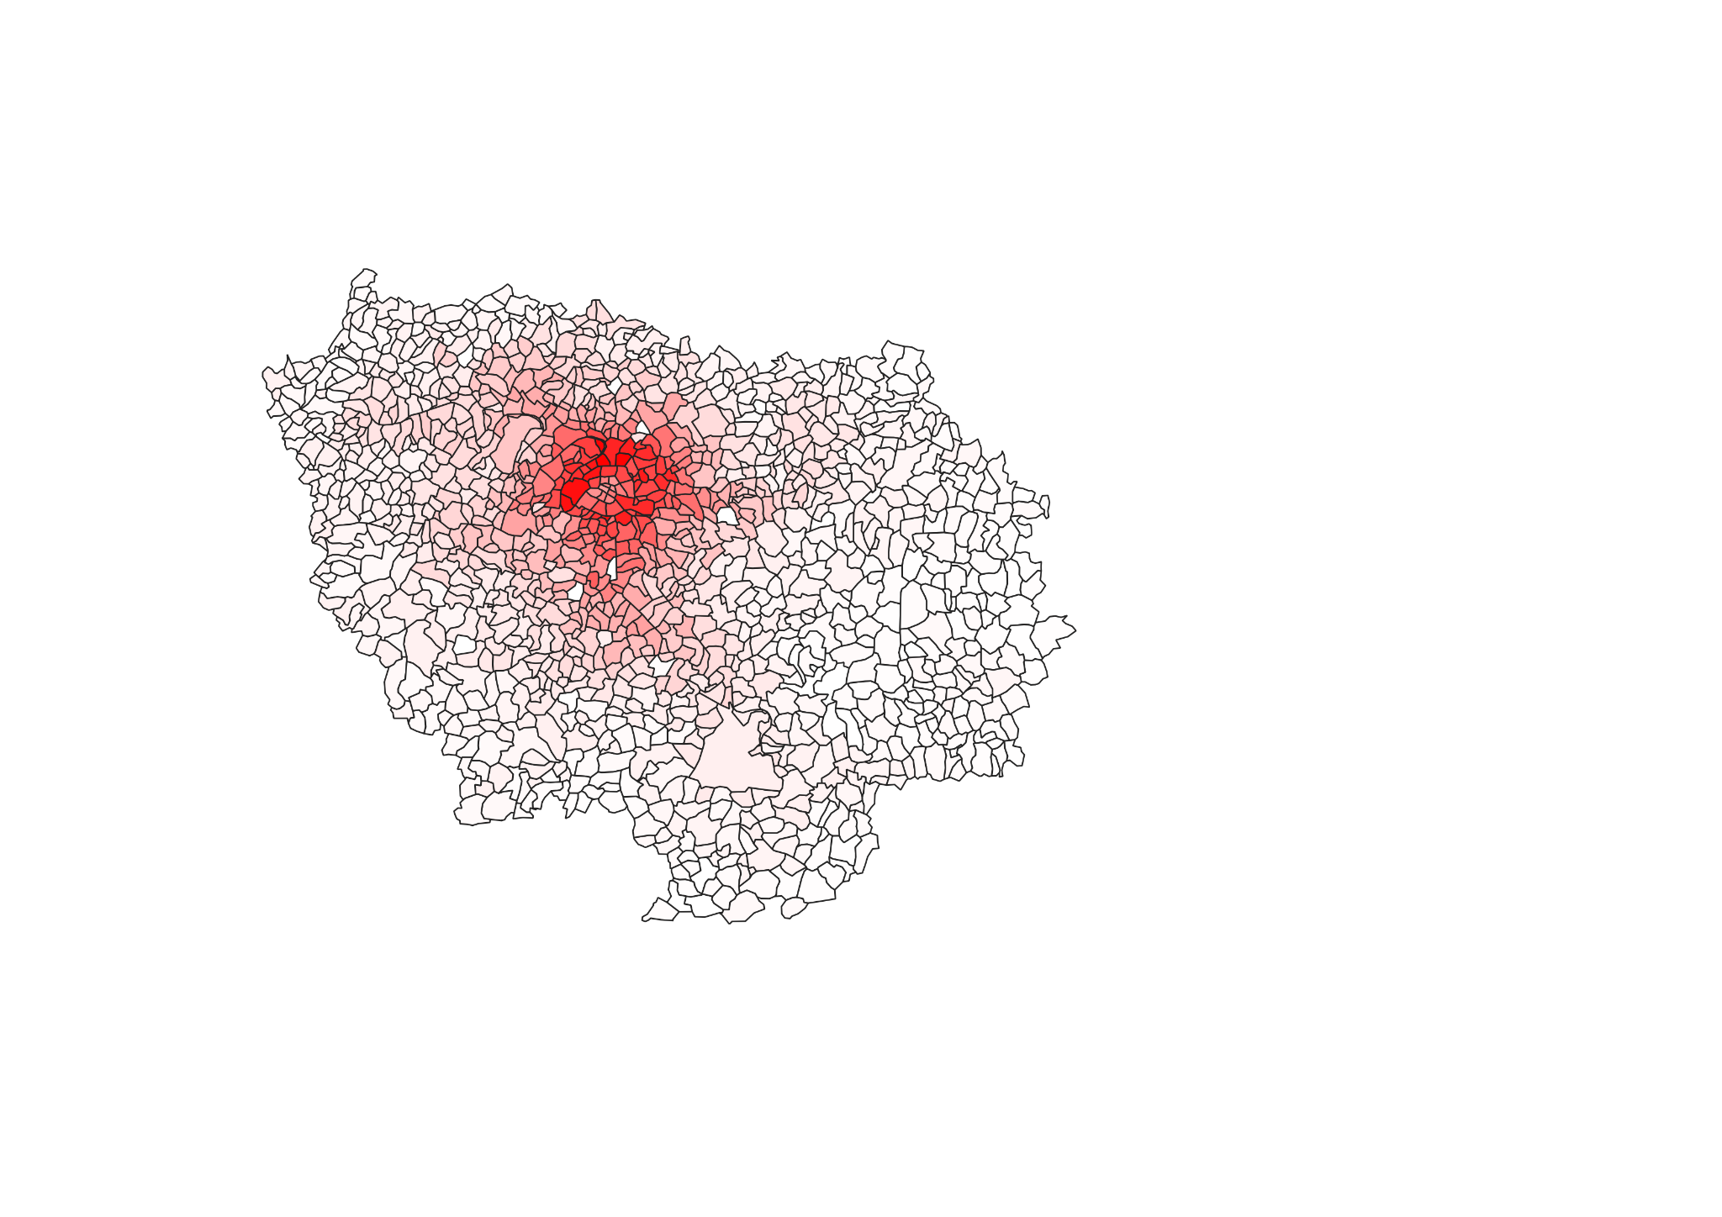
Indicateur: Nombre d’infrastructures sportives accessibles à 15 minutes en voiture
Région Ile-de-France
Number of sports facilities per communes,
Absolute number
Number of sports facilities per commune,
Cut into deciles

Slide 40
Indicateur: Nombre d’infrastructures sportives accessibles à 15 minutes en voiture
Problem:
Current method : OSMR package on R → 1 whole night to calculate isochrones for 2000 communes
36,000 communes
15,000 IRIS
→ method : department by department and then merging
Alternative method tested : “OSMR tools” in QGIS → limited to 500 isochrones zones per day, 5 zones per treatment

Slide 41
Determinant - Access to jobs, services and facilities

Slide 42
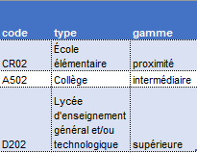
Indicateur: Taux de services de proximité accessibles à 6 min. en voiture
1st step : Create isochrones
2nd step : Calculate inside service rates
Data : GPS coordinates of all services
→ 1 point = 1 equipment
Locating services in isochrones
Use a passage table to select only “services de proximité”
Calculate the percentage of proximity services actually present in the isochrone
Passage table - BPE
Data source : Base permanente des équipements, INSEE

Slide 43
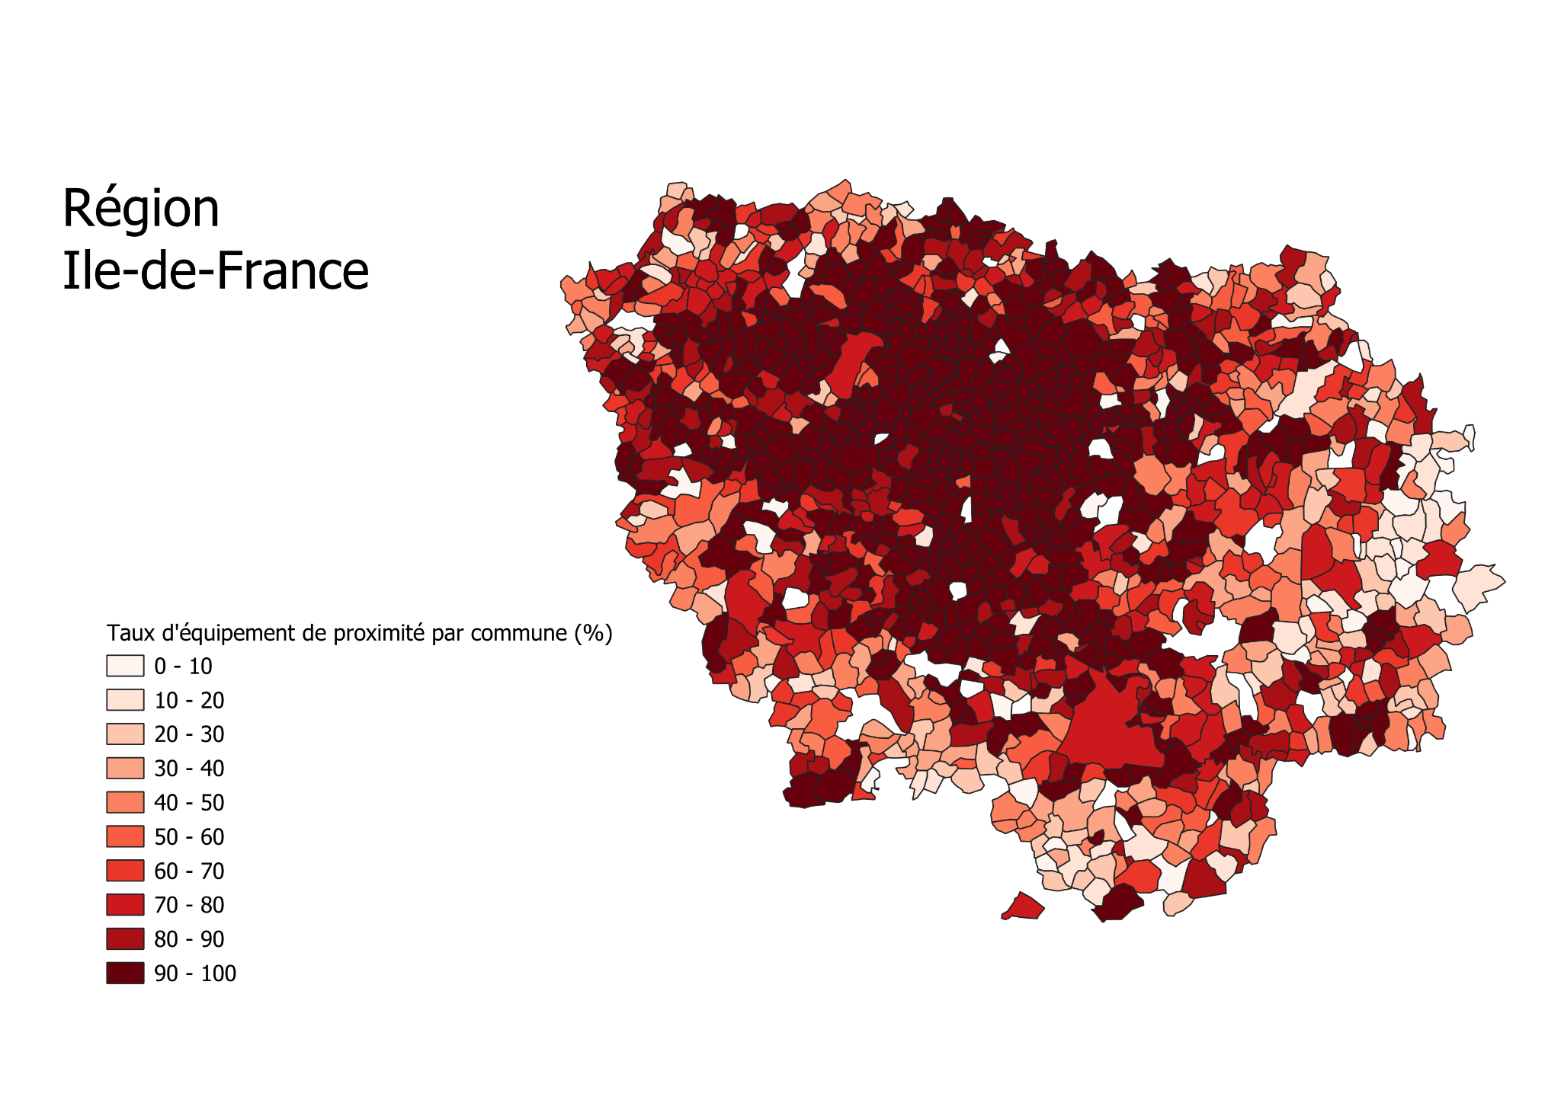
Indicateur: Taux de services de proximité accessibles à 6 min. en voiture

Slide 44
Indicateur: Taux de services de proximité accessibles à 6 min. en voiture
Problem : Same as before
taux de services de proximité accessibles à 6 minutes
taux de services intermédiaires accessibles à 12 minutes
taux de services supérieures accessibles à 21 minutes
Alternative : Existing indicator on the INSEE website at commune level
Part de la population éloignée des équipements de proximité à 7 minutes
Part de la population éloignée des équipements intermédiaires à 15 minutes
Part de la population éloignée des équipements supérieur à 30 minutes

Slide 45
Other indicators found

Slide 46
Déterminant 1 - Qualité de l’air
Counts of ambroisies detected by département for 2022
Déterminant 9 - Sécurité :
Coups et blessures volontaires (taux) 2022
Vols sans violence contre des personnes (taux) 2022
Cambriolages de logement (taux) 2022
Usage de stupéfiants (taux) 2022
Déterminant 10 - Accès à l’emploi, aux services et aux équipements
Part de la population éloignée des équipements intermédiaires, 2021
Part de la population éloignée des équipements de proximité, 2021
Part de la population éloignée des équipements supérieurs, 2021
Part de chômeurs de 15 à 64 ans en 2020 (sur personnes actives)
Taux de cyclabilité
Déterminant 12 - Alimentation
Pourcentage de parcelles bio
Determinant 13 - Habitat
Sur-occupation du logement
Déterminant 14 - Revenu
Part de ménage pauvres
Indicateur de défavorisation social
Mixité générationelle :
Part des pers. âgées de - de 25 ans 2020
Part des pers. âgées de 25 à 64 ans 2020
Part des pers. âgées de 65 ans ou + 2020
Mixité sociale :
Part des ouvriers au lieu de travail en 2020
Part des employés au lieu de travail en 2020
Part des cadres au lieu de travail en 2020

Slide 47
Next steps
Compile all the different indicators in a single format
Code for once data is at highest resolution to group into IRIS, Commune, Département et Région
Visualisation (in RShiny) of all indicators collected

